Slide 1
Automated household content claims
Notes:
Photo by Rakicevid Nenad - https://www.pexels.com/photo/silhouette-of-man-raising-hands-against-a-red-sunset-light-under-green-clouds-801885/

Slide 2
Introduction
www.slvrcld.com
2019 Netherlands
Thesl expansion
Bootstrap Small dynamic team
Notes:
SLVRCLD was registered in 2019 in the Netherlands and forms part of Thesl’s international expansion. Thesl is the de facto platform in South Africa used by the majority of insurers to quantify and settle their non-motor content claims. We are a bootstrapped business with a small but very dynamic team. Currently we are 8 people of which 3 are engineer, to simplify the complex data structures, and 2 senior developers.
Photo by Tom Swinnen - https://www.pexels.com/photo/vintage-black-windmill-during-sunset-952632/

Slide 3
Vision
Improving people's lives* by making content insurance effortless and fair.
www.slvrcld.com
Notes:
* We do not only want to just improve the lives of policyholders, or those unfortunate enough to become claimants, but also those of the claims handlers, and the stakeholders behind insurers and suppliers. Photo by Yuting Gao - https://www.pexels.com/photo/silhouette-of-two-person-standing-during-nighttime-1567069/

Slide 4
Problem
No automatic quotes
Long and laborious process
Settle on client quote
Notes:
The problem for personal line insurers is that a human needs to quantify a claim manually from panel suppliers, which is not suitable in a work from home environment where you have to be flexible. It becomes a long and laborious process contacting panel suppliers, collating quotes and then determining the right quantum. With extremely demanding clients and the longer the process takes the less trusting a claimant becomes.
This results in an expensive settlement process where the client is then usually settled in cash at the client’s quote, which is usually 20% higher than obtainable from your panel.
There is also no possibility of a robotic processed replacements, which we think will be a differentiator in the short-term but become the norm in 5 years.
Photo by Moose Photos - https://www.pexels.com/photo/man-wearing-brown-suit-jacket-mocking-on-white-telephone-1587014/

Slide 5
Quantifications
Structured item dataset
With ML determine the correct replacements
Request tender if not available
www.slvrcld.com
Accurately identify the claimed item
Price from normalised quotes
Settle via best possible method
Notes:
We are able to do this as we have developed a large structured item dataset to correctly identify the claimed item and determine the correct replacements. This was done through machine learning and analysing millions of insurance quotes. These items are then quantified by mining our inventory quotes that were obtained from supplier API’s, pricing feeds, recycling quotes and as a last resort via screen scraping. If pricing is available quotes will be supplied immediately otherwise it will break out to a quick tender process.
The claims agent or business rules can then determine the best settlement type. Photo by Bongkarn Thanyakij - https://www.pexels.com/photo/white-ceramic-mug-on-white-table-3840880/

Slide 6
Settlement methods*
Vouchers
Debit card
www.slvrcld.com
Purchase order
Cash-in-lieu
* Country dependent
Notes:
There after the claim can be settled through virtual vouchers, pre-paid filtered debit card or direct award via a purchase order, which is being phased out. If an insurer elects they can still settle the claim through their normal cash-in-lieu process at the better price of course. Photo - https://www.pexels.com/photo/woman-in-brown-coat-sitting-on-bench-3784379/

Slide 7
Categories
PHOTOGRAPHY
MOBILE DEVICES
Binoculars, cameras & lenses
Cellphones, GPS, tablets & wearables
LUGGAGE & SUNGLASSES
PENS & WATCHES
APPLIANCES
SPORTS EQUIPMENT
Dishwashers, fridges, freezer, stoves & microwaves, tumble dryers, vacuum cleaners & washing machines
Camping, cycling, exercise, fishing, golf, horse riding, scuba & watersports
AUDIO VISUAL
DRONES
Decoders, Blu-ray players, home theatre systems, projectors & televisions
HOME & GARDEN
ELECTRONIC GOODS
Beds & furniture & garden equipment
Calculators, photocopiers, power tools
COMPUTERS
GAMES & CONSOLS
Computers, laptops, printers & software
Notes:
These are all the categories where we are able to help insurers and the easiest way to describe it is if you take a home and flip it over anything that falls out that has a make and a model is what we can quantify.

Slide 8
Network
Insurers, MGA’s & Brokers
Web Portal
API
Platform
Panel Suppliers
snappy.claims
Claimant
OEM’s
Data Engine
Data Vendors
Notes:
Insurers, underwriting managers and brokers are able to access our system through our enterprise API’s or access the system through our front-end while piloting the solution. This accesses the data engine with structured item dataset and supplier quotes. Our application runs on AWS Lambda and with it being a server less hosting has near unlimited scaling while our data environment is hosted on EC2.

Slide 9
Quicker claim
Identify item(s)
Supplier quotes
Collate quotes
Reconcile & pay
Incident
FNOL
Award
Invoice
Normal claim 1 to 4 days
Augmented claim +/- 4 hours
Automated claim < 1 hour
Speed up the process by a factor of multiples ~ creates trust
Notes:
Speed up the claim by a factor of multiples from days to an hour which creates trust and prevents client moving to other another underwriter after the claim.

Slide 10
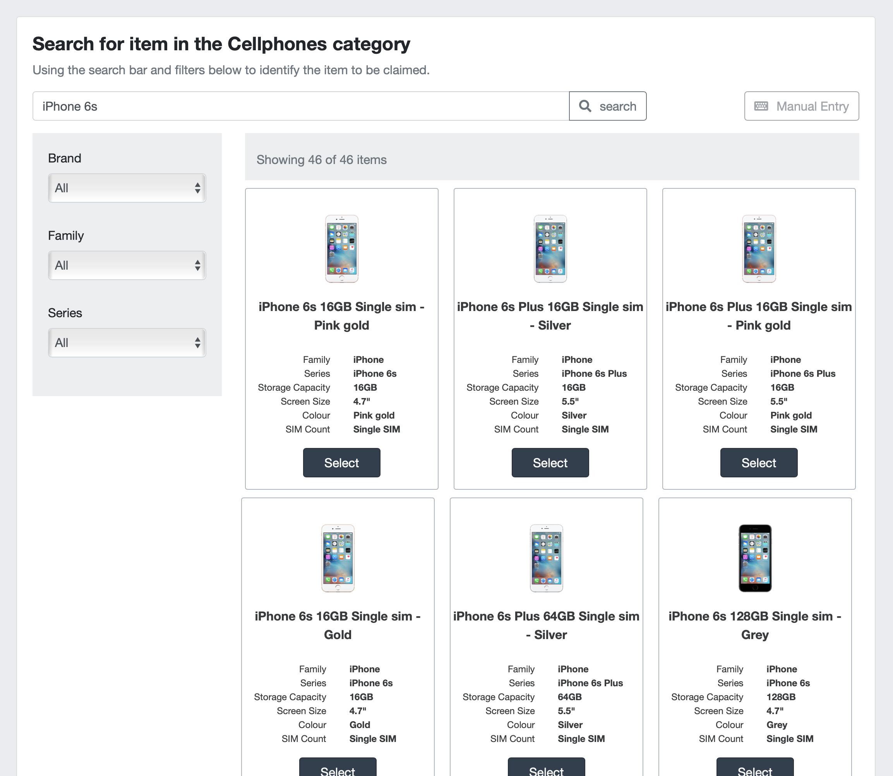
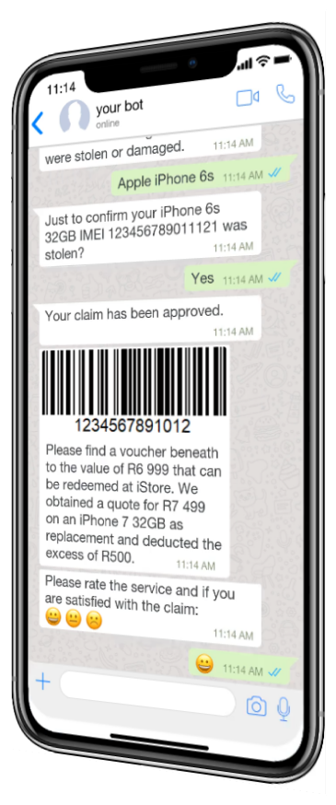
Overall better claims experience
Preferred channel
Lower claims cost = Improved loss ratio = Lower premiums
Reduces risk of client moving to other insurer after an incident
Notes:
Much better claim experience where you communicate to the client via their preferred channel.

Slide 11
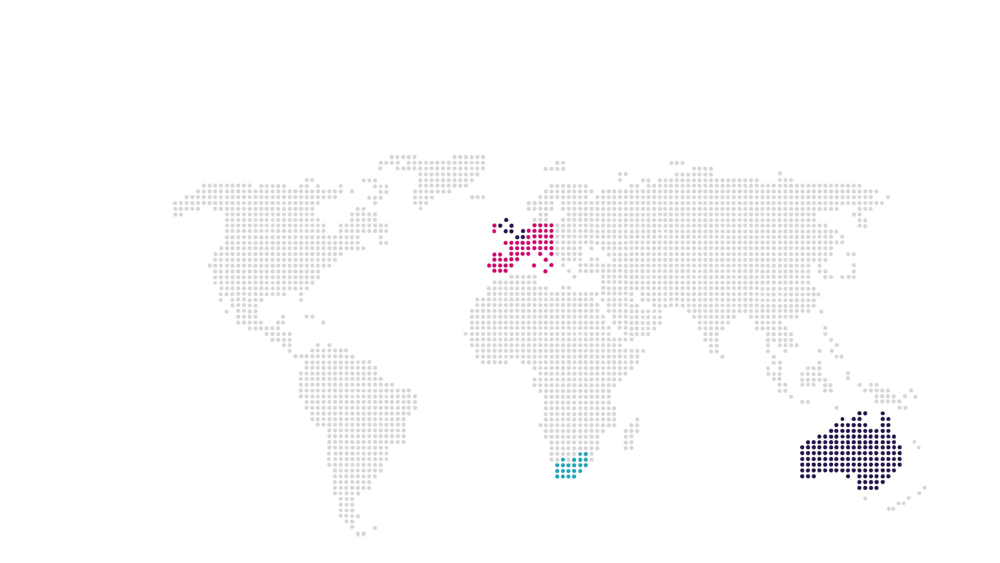
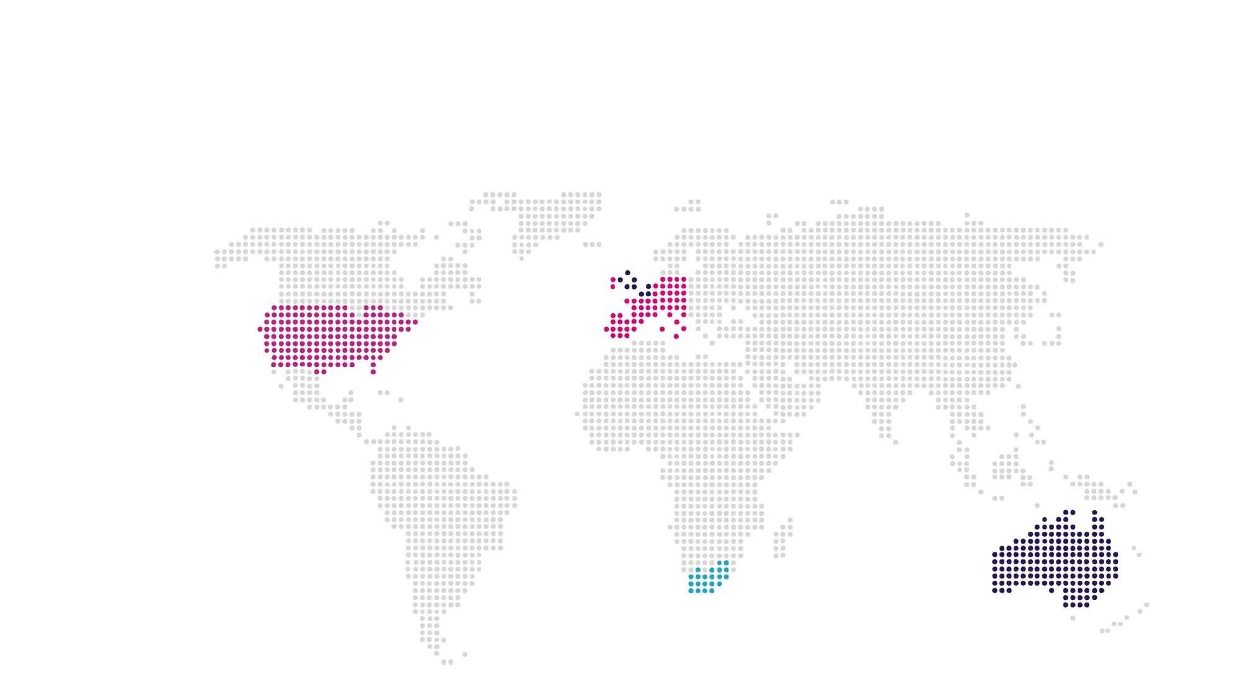
Country roll-out
2020
UK
2020
Netherlands & Belgium
2024
North America
www.slvrcld.com
2021
European expansion
2020
South Africa
2021
Australia
Notes:
Our aim this year is to roll-out the automatic platform to South African insurers while finalising our discussions with a UK reseller and piloting in the Netherlands and Belgium. While growing these markets next year and expanding into Europe we are looking at Australia and if all goes well we will hopefully be in a position to target the US in 2024.

Slide 12
#goodbyemanualclaims Please contact me for question or a demo
Address
Trompstraat 141, 2014BH Haarlem, North Holland, The Netherlands
Telephone
+31 63 833 9494
Email
christiaan@slvrcld.com
Notes:
Thanks for your time and if you have any questions please do not hesitate to contact me.

